Slide 1
Economic Development & Integral Human Development
Lectures 23-26

Slide 2
Plan for Lectures
Concepts of Development
Integral human development
Economic development
Happiness research
Economic growth and development
Is economic growth essential?
Does economic development include all people?
Development policy and barriers to development
Macro policy failures and successes
Barriers to development
Micro approach to development
Globalization and development
The role of international organizations
Gains from globalization
Cultural and economic opportunities and challenges

Slide 3
I. Concepts of Development

Slide 4
I) A. Integral Human Development
In 2017, Pope Francis founded the Dicastery for the Promotion of Integral Human Development, which combined four Pontifical Councils under one roof:
Justice and Peace
Pastoral Care of Migrants and Itinerant People
Pastoral Assistance to Health Care Workers
Cor Unum (“One Heart”) – umbrella for Catholic charitable organizations
Also in 2017, students enter Keough School of Global Affairs with mission to advance: “integral human development through research, policy and practice; transformative educational programs, and partnerships for global engagement”

Slide 5
What is integral human development?
CST approach to development
Def.: integral human development: progress of individuals toward full potential or authentic human flourishing
Authentic means according to God’s plan and human nature

Slide 6
What is integral human development?
CST approach to development
Def.: integral human development: progress of individuals toward full potential or authentic human flourishing
Authentic means according to human nature and God’s plan

Slide 7
Integral Human Development of the Whole
Recall the etymology (“integrity”, “integral”); integer means whole
When are humans “whole”?
2 aspects
Involves the whole person (physical needs, spiritual needs, social needs, psychological needs, etc.) – stems from the dignity of the person
Involves the whole of society – all persons and groups of people – a reflection of solidarity/subsidiarity, goal of communion with God and other persons
Not merely technological progress, amassing of material wealth, increase in technical capabilities, social Utopianism
Ultimately, integral human development is oriented toward God, fulfilling man and society’s purpose in God’s plan – recall Lecture 1 and the meaning of life

Slide 8
Integral Human Development of the Whole
Recall the etymology (“integrity”, “integral”); integer means whole
When are humans “whole”?
2 aspects
Involves the whole person (physical needs, spiritual needs, social needs, psychological needs, etc.) – stems from the dignity of the person
Involves the whole of society – all persons and groups of people – a reflection of solidarity/subsidiarity, goal of communion with God and other persons
Not merely technological progress, amassing of material wealth, increase in technical capabilities, social Utopianism
Ultimately, integral human development is oriented toward God, fulfilling man and society’s purpose in God’s plan – recall Lecture 1 and the meaning of life

Slide 9
I) B. Economic Development
Economic development has several focuses:
Income per capita
Poverty rates
Other transitional phenomena – structural change, demographic transition, urbanization, dynamics of inequality
Persistent problems in poor countries – corruption, poor health care/sanitation, low education, poor financial access, child labor, agricultural and rural economics, informal markets, etc.

Slide 10
Principle Measure of Overall Economic Development
GDP/Capita (recall issues)
Strengths:
Simple, quantifiable, available
Correlated with other measures of well-being
Utility-based aggregate measure
Limitations:
Accounting issues (e.g., government)
Omits non-market production (e.g., raising own children, leisure)
Imperfectly correlated with other measures

Slide 11
Alternative Measures
Human Development Index:
U.N. attempt to “shift the focus of development economics from national income accounting to people centered policies’’
Three dimensions:
long, healthy life: (life expectancy at birth)
access to knowledge: (average, expected years of schooling)
decent standard of living: (GDP per capita at PPP)
Attempt to measure broader “capabilities” (Sen, Nussbaum)
Doesn’t fit into models very well

Slide 12
Recent Research
Utility based measure incorporating
leisure,
life expectancy
inequality
expected utility, equal chance of being any person
But back to thinking about cardinal utility
Happiness research – subjective well being

Slide 13
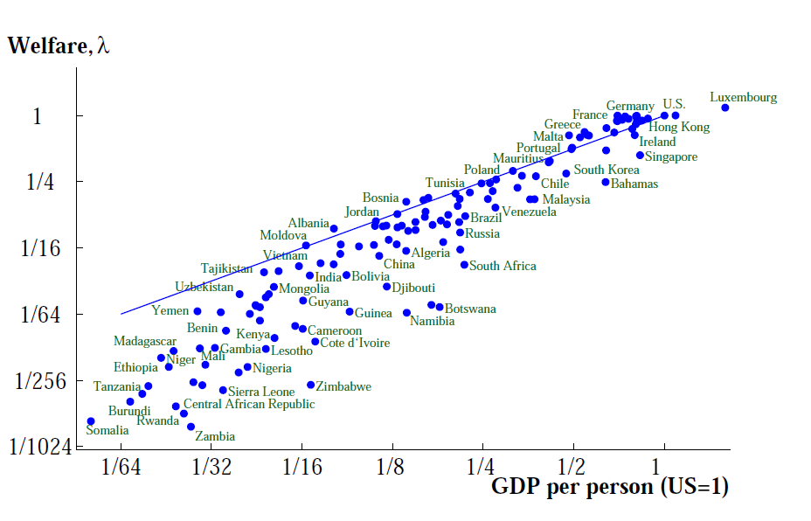
Results similar, though poor countries worse off

Slide 14
What do these measures omit?
Personal virtue (e.g., honesty, charity, hope)
Personal initiative (opportunity, means, self-realization, co-creation, purpose/meaning)
Social relations (e.g., family, community, etc.)
Unmeasured public goods (e.g., environment, peace/defense)
Others?

Slide 15
What do these measures omit?
Personal virtue (e.g., honesty, charity, hope)
Personal initiative (opportunity, means, self-realization, co-creation, purpose/meaning)
Social relations (e.g., family, community, etc.)
Unmeasured public goods (e.g., environment, peace/defense)
Others?

Slide 16
Recent Research
Utility based measure incorporating
leisure,
life expectancy
inequality
expected utility, equal chance of being any person
But back to thinking about cardinal utility
Happiness research – subjective well being (SWB)

Slide 17
Happiness research
Why not just ask people directly?
Three common survey measures of subjective life satisfaction or “subjective well-being”:
All things considered, how satisfied are you with your life as a whole these days? (scale of 1-10)
Taken all together, how would you say things are these days—would you say that you are very happy, pretty happy, or not too happy?
Much of the time during the past week, you felt you were happy. Would you say yes or no?

Slide 18
Issues with Happiness Research
Questions are subjective:
Are people fully informed?
Do people appreciate what they have?
Do they know what they are missing?
Do they value the right things to be truly happy?
May be tied to moods, whims, etc.
Scale is arbitrary and ambiguous, e.g., 1-10
Choices and improvements in SWB correlated but not perfectly
People often claim to make choices that they predict would hurt there SWB

Slide 19
More on Choices and Subjective Well Being
List of hypothetical choices given people (Benjamin et al, 2012)
E.g., sleep vs. income
Option 1: A job paying $80,000 per year. The hours for this job are reasonable, and you would be able to get about 7.5 hours of sleep on the average work night.
Option 2: A job paying $140,000 per year. However, this job requires you to go to work at unusual hours, and you would only be able to sleep around 6 hours on the average work night.
Other options: going to an already purchased concert vs. friend’s birthday; absolute income vs. relative income; legacy vs. easy life; money vs. time; socialize vs. sleep; family vs. money; education vs. social life; interest vs. career; concert vs. duty; low rent vs. short commute; friends vs. income; Placebo: apple vs. orange
Asked about what you value in your life: your own happiness, your family’s happiness, your health, your romantic life, your social life, your control over your life, your life’s level of spirituality, your life’s level of fun, your life’s “non-boringness”, your physical comfort, and your sense of purpose
Systematic evidence that choices disproportionately favor absolute income over legacy, relative income, sleep, being around friends, having more time, visiting family
Your own happiness is single biggest predictor of choices, but deviations are systematically predictable in that they make choices deviate from SWB:
sense of purpose
control over one’s life
family happiness
social status
Spirituality matters for choose legacy over easy life

Slide 20
II. Economic Growth and Integral Human Development

Slide 21
II) A. Does economic growth include all people?
Integral human development includes all people, but large disparities exist in many developing countries:
Agrarian vs. Industry
Rural vs. Urban
Women vs. Men
Indigenous vs. European Descent

Slide 22
1. Agriculture lags behind industry
Productivity differs by a factor of six across industry and agriculture for poor countries
Incomes are also much lower in agriculture
Def. dual economy – a rich modern sector and poor agrarian or informal sector coexist in same economy
“Agricultural Productivity Puzzle”: productivity lags but poor countries often have a majority of their workers in agriculture
Church emphasizes plight of agricultural workers, but this is also likely due to problems hiring in industry, unions, minimum wages, migration, education, etc.
Related, rural areas lag – part of geographically concentrated development, migration issues

Slide 23
2. Inequities between women & men
Women have worse conditions in poor countries, especially in Asia
Nobel Laureate Amartya Sen estimated 100 million “missing women” in the world
In developed world, slightly more women than men, but in poor countries many more men
Higher death rates among women because of infanticide, poorer nutrition and medicine in infancy, violence, harder work
Lower birth rates for women
Poor in vitro nutrition, selective abortion

Slide 24
Indigenous Peoples
Indigenous people tend to have lower incomes
E.g., Brazil
Mixed Race: $2400/year
Whites: $3600/year
E.g., South Africa
Blacks
80% of population,
median income=12,000 ZAR ($1700/year)
Whites
10% of population
median income= 65,505 ZAR ($9200/year)
These gaps exist in advanced economies too
Recall that countries with higher European descent populations have higher incomes generally, however.

Slide 25
II. B) Is economic growth essential?
How does economic growth relate to integral human development
Possible positive roles of economic growth
Job creation
New goods and services of genuine benefits, e.g., cures for disease
Economic dynamism: co-creation, application of God’s gifts
Rising tide lifts all boats
Possible negative roles of economic growth
Environmental degradation, sustainability concerns
Consumerist distractions from more meaningful life: having vs. being
Less leisure, time to appreciate family, friends, etc.
Leaves subgroups behind, polarization

Slide 26
How should we think about flourishing/development?
China – tremendous economic growth but no religious freedom and high level of materialism (e.g., Christmas without Christ), few human rights, rising disparities within and across regions
Philippines – 2012 bill promoting population control for economic growth, poverty reduction
U.S. (next page)

Slide 27
U.S. Post-1970
Economic:
Economic growth, but real wages have not risen as quickly for median worker – higher inequality
Lots of new products, technologies available
Social:
College education has increased
Divorce rates have risen
Abortion has exploded
Race relations have improved
Religiosity has fallen

Slide 28
Notes:
At the same time, we see a decline religiousity, the fraction of people who affiliate with any religion, and religious giving.
This spiritual decline is real and measurable. I was surprised that this wouldn’t come up in a theologian’s paper on the religion of economics.
Maybe this reminds theologians to be careful where they throw stones. We economists don’t look so bad in this picture.
Why do we see this decline in religiosity?
Is the market economy responsible ? Partly, perhaps. Advertising may lead to an emphasis of material over the spiritual… and wealth certainly creates the illusion of independence…but I don’t think its purely income or the type of economy. Certainly, the picture would be starker for Western Europe, where markets are more regulated, and even moreso in Communist countries.
Social science factors like changing society, family structure also certainly play a role
I don’t think we should ignore the power of the history of ideas, however. Religion has been losing in the marketplace of ideas in recent times, and not for lack of a good product. A lack of religion is more strongly correlated with education than with income. Are they learning this in their economics courses or is the onus on theologians. Perhaps, the past cohort of theologians have failed to provide students with anything sufficiently compelling, substantive, or well-articulated as an alternative to atheism, materialism, secularism, or economics for that matter.
Is the market to blame? Perhaps, maybe advertising does make us more concerned with the material and less concerned with the spiritual. Maybe high incomes give us a false sense of independence. But the trends are certainly starker in Western Europe, where markets are more tamed, and even moreso in Communist countries.
Social science also has something to say hear. The changing societal structure and changing family structure certainly play a role.
But I don’t think we can ignore the power of the history of ideas. In recent decades. the spiritual side is losing the battle in the marketplace for ideas, and not for want of a good product. A lack of religiosity is more closely correlated with education than with income.

Slide 29
Questions for Discussion
Does economic growth alleviate or exacerbate disparities between groups?
Is economic growth essential to human flourishing?
Is growth in accord with human nature?
Should it be a policy goal?

Slide 30
End of Lecture 23

Slide 31
III. Development Policy and Barriers to Development
Many initiatives both within countries and globally to promote development
Wide range of goals:
E.g., United Nations’ 17 Sustainable Development goals for 2030:
No Poverty or Hunger (1 and 2)
Good Health and Well-being
Quality Education
Gender Equality - (2015 “Millennium Goals” included universal access to contraception, and “unmet needs” for family planning, contrary to CST)
Clean Water and Sanitation
Affordable and Clean Energy
Decent Work and Economic Growth
Industry, Innovation, and Infrastructure
Reducing Inequality
Sustainable Cities and Communities – largely housing
Responsible Consumption and Production
Climate Action
Life Below Water and Life on Land (14 and 15)
Peace, Justice, and Strong Institutions and Partnerships (16 and 17)
More emphasis on environmental sustainability than Millennium Goals for 2015
Oddly no mention of flourishing family or community bonds

Slide 32
Macro research: accounting for cross-country differences in average incomes
Motivation: should macropolicy focus on education, savings/investment, or productivity?
We need to account for a factor of 30 difference in output per worker between U.S. and Nigeria (largest very poor country)
Capital per worker – factor of 1.5 to 2
Human capital per worker – factor of 2 to 2.5
Productivity is the rest – factor of 6 to 10
Most research over the past 20 years has focused on productivity
Recent literature using immigrant wages and emphasizing quality of education and experience attribute more to human capital and less to productivity

Slide 33
III) A. Macropolicy Failures & Successes
Over the past 50 years, we have had dramatic successes and horrible failures
We can learn some lessons from these
Generally, the successes have been in East Asia
Asian tigers (South Korea, Taiwan, Hong Kong, Singapore)
Second and third waves (Thailand, Indonesia, Malaysia, China, Vietnam)
But some other successes too (Chile, Mauritius, Botswana)

Slide 34
Many policies failed
Education – high rates of growth, especially in Africa (primary education, literacy), but not economic growth
Foreign aid, credit – aid to countries often misused, go to foreign dictators, didn’t increase investment
Debt forgiveness – similarly, did not promote growth
Health measures – increased life expectancy, but not economic growth
Protectionism – led to stagnant economies
Central planning – led to disasters
Policies may be important but not sufficient

Slide 35
Debt relief
Post-WWII, international institutions and “Big Push” attempt at development
Development credit (e.g., World Bank), emergency crisis credit (e.g., IMF), poor government decisions led many developing countries saddled in debt
Millennium initiative for foreign debt forgiveness (Pope JP II, Bono, Angelina Jolie, Jeffrey Sachs)
Religious inspiration: Jubilee Year (2000)
Economic inspiration: Debt overhang theory
People saddled with debt are effectively taxed at high rate, since money goes to lender
Incentives to invest, work hard, etc. distorted, leads to gambling to survive
Investors themselves are unlikely to get paid either way
Same rationale behind bankruptcy laws

Slide 36
Market economies > Centralized
North Korea: $1700, South Korea $39,500 (2017)
Taiwan: $50,500, China: $16,700
China: 1950-1978: didn’t double
1978-2006: quadrupled
Vietnam: $6900, but high growth since decentralizing in 1986
China’s Great Leap Forward, 1958-62:
Mao’s attempt to centrally industrialize
25-60 million starve to death in famine
In terms of numbers, greatest human tragedy in history

Slide 37
Venezuelan Crisis
Socialist regime started in 1999 under Hugo Chavez, now Nicolas Madura
Oil price grew 7 fold from 1999 to 2008 , and GDP/capita grew 2.5%/year
oil prices halved from 2008 to 2017,GDP by 5.4%/year from
Hard to get reliable data since, but:
GDP estimated to drop 25% in 2019, unemployment >40%
Hunger, poverty, and outmigrants
Hyperinflation since 2017, 8 million percent in 2019
In relative terms, worse than Great Depression
Not a centrally planned economy, but
Highly authoritarian government
Highly redistributive policies
Large social spending, exceeding revenue
Active price controls on food, currency
100,000 government funded communes/businesses
Poor property rights/high level of expropriation: e.g., first oil industry, then supermarkets, housing/construction, etc.

Slide 38
Commonalities among successful economies
Hard to know which policies were key:
Openness – trade surpluses, tended to subsidize export industries rather than import-competing industries
Savings and investment – East Asian countries saved and invested at very high rates (Africa now growing through high capital accumulation)
Stable macroeconomies – low inflation, roughly balanced budget, stable exchange rates
Strong governments – reliable leadership, investment in infrastructure, education, etc.
Increase in productivity

Slide 39
Barriers to Growth
Many related to the themes we’ve discussed:
Poor government institutions
Literature on French vs. British legal origins
Poor financial development
Poor property rights
Corruption
Extractive/Elitist institutions vs. Inclusive Institutions (Acemoglu, Johnson, Robinson)
Monopoly rights of various groups
Industry
Trade unions
Political powers
Poor technologies
Lack of entrepreneurs
Lack of infrastructure (transportation, communication, financial)
Lack of foreign investment/integration
Political/military conflict
Ethnic fighting, religious conflict
Ideological factions

Slide 40
Ex: Corruption as Random Taxes and Prisoner’s dilemma
Consider a business person who must
Disorganized corruption can be worse than organized corruption
Consider two agents that both try to decide whether to bribe – bribes look like taxes to business owners
Deciding independently can lead to bad outcomes where you kill the project, but no single person would decide on this even if corrupt
Single corrupt dictator doesn’t kill the goose that lays the golden eggs.

Slide 41
Corruption as Random Taxes and Prisoner’s dilemma
Person 1 Person 2: | Be Honest | Be Corrupt
Be Honest | (10,10) | (10-b-e,10+b)
Be Corrupt | (10+b,10-b-e) | (10-e,10-e)

Slide 42
Corruption Examples
Iraq under Hussein, Iraq post-war
Russia under Soviets vs. Russia post-transition
Suharto in Indonesia vs. corruption in Kenya

Slide 43
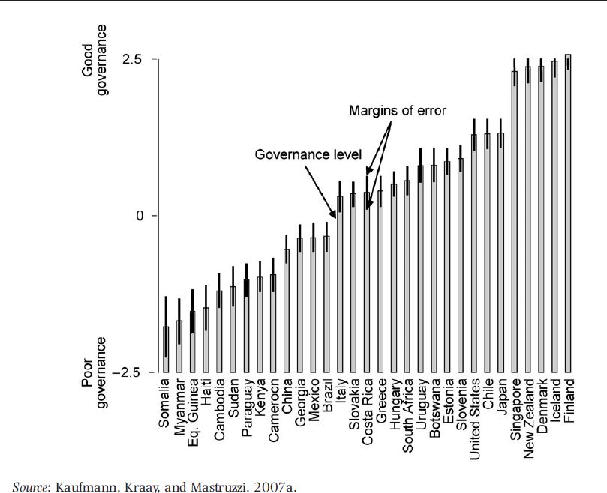
Measures of Government Corruption

Slide 44
III) B. Micro Approach to Development
Big Idea (Banerjee, Duflo, and Kremer Nobel, 2019):
easier to learn about micro policies than macro policies: use randomized control trial (RCT) experiments
relies on empirics rather than theory
small improvements in nutrition, health care, education, agricultural technologies, financial services, communication technologies, governance, migration, etc. improve the lives of people
may give insights into the larger issues that the poor face
Ethics: typically can’t afford everyone, don’t know if it works, and randomization is more fair than connections/corruption
LEO (ND’s Lab for Economic Opportunities): same approach in U.S.

Slide 45
Criticisms of RCT Micro Approach
Micro emphasis ignores larger macro issues
RCTs need theory to interpret/extrapolate results
Small RCTs may not have same impact when scaled
May not have same impact in other situations
Focus is on aid policies, behavioral economic biases
Poor in developing countries may be less dependent on aid than poor in advanced economies – breed dependence?
Is this really the difference between Uganda and S. Korea experience over the past 50 years?
Ethics:
Experimenting on people is problematic, especially experimenting on the poor
Withholding services from the “control” is problematic

Slide 46
End of Lecture 24

Slide 47
III. Globalization and Development
We will consider three aspects:
Overview of Globalization
International organizations and cooperation
Cultural and economic opportunities and challenges
Gains to globalization
Economic winners and losers
Cultural challenges

Slide 48
III) A. Overview of Globalization
Globalization is the increased economic, political, and social integration of countries
It involves several aspects:
International trade
International capital/financial flows
International migration
Multilateral political intertwining
Increased cultural, information flows

Slide 49
What has driven globalization?
Decreased transportation costs: technological improvements lead to cheaper air, sea transportation
Decreased communication costs/information exposure: telephone, computers, internet, foreign language, television, movies, social media
Increased international cooperation – multinational cooperation, trade agreements, etc.
Gaps in living standards were long present – but they have become more apparent through (2)
More?

Slide 50
What has driven globalization?
Decreased transportation costs: technological improvements lead to cheaper air, sea transportation
Decreased communication costs/information exposure: telephone, computers, internet, foreign language, television, movies, social media
Increased international cooperation – multinational cooperation, trade agreements, etc.
Gaps in living standards were long present – but they have become more apparent through (2)
More?

Slide 51
III) B. International Organizations and Cooperation
After WWI, Woodrow Wilson pushed the League of Nations, but the U.S. didn’t join
After WWII, need for international cooperation was recognized:
promote reconstruction (Europe, Japan) and development (3rd World)
prevent war (WWII) but also trade wars (Great Depression)
Backdrop of the Cold War (1st and 2nd World)

Slide 52
Peace, War, and Solidarity
Defn. peace – a well-ordered concord (Augustine, Aquinas)
Concord means agreement or harmony
Well-ordered means following the objective moral order
One can talk of interior peace (within a person) and external peace (among persons)
Peace is a value of CS doctrine:
“Blessed are the peacemakers for they will be called children of God.” Matthew 5
Church works for peace, but recognizes importance of self-defense, civil order, etc.
government has authority to use proportionate force , e.g., preventing murder, apprehending a murderer
Jesus was peaceful but never condemned soldiers
Just War doctrine (but no war can be justified on all sides)
In many ways, war is an absence/breakdown of authority – no global authority for police action – which helps explain support of U.N.
Church has cautioned against arms race – peace is different than absence of war, must have true solidarity

Slide 53
Global Peace and Just War Theory Catechism 2307-2330
Requirements:
Damage inflicted by aggressor nation must be lasting, grave, certain
Other means are impractical/ineffectual
Must have prospects for success (no war in vain)
How?
Force must be proportionate
Means must moral (e.g., no non-combatants targeted)
Who decides?
Legitimate authorities representing common good

Slide 54
International Organizations
United Nations (UN) (1945) – governing organization for promoting cooperation in law, security, human rights, development, peace
World Bank (1944) – bank that lends for international development
International Monetary Fund (IMF) (1944) – institution for preventing currency crises/financial crises, lends for crises, monitors and assists
World Trade Organization (WTO) (1994)– international court for trying trade disputes, replaced GATT but with developing countries included (US didn’t ratify ITO in 1948)

Slide 55
Other International Agreements
Org. for Economic Cooperation and Development (OECD) (1961) – cooperate on economic best practices, taxation
Basel I, II, III, IV Accords – cooperative agreements on bank regulatory policy and oversight
North American Free Trade Agreement (NAFTA) – 1994 Mexico, US, Canada trade agreement, to be replaced by USMCA
Paris Accords (2015) – agreement to keep global temperature below 2 degrees above pre-industrial level, cut emissions

Slide 56
International Governance
Globalization and mobility of factors limits the exercise of power of sovereign states
Difficult to enforce national laws internationally
Difficult to regulate (e.g., taxation)
Inter-sovereign competition might be good, might be a race to the bottom (e.g., social policy, environment)
CST has often called for international organizations: e.g., World Fund, global governing authority, global financial regulator.

Slide 57
Solidarity, Subsidiarity, and Authority
International organizations have been criticized for violating sovereignty both by right (United Nations – “New world order”) and left (World Bank, IMF, WTO – “global capitalism”)
Authority and solidarity lead to global institutions
Supported in principle by CST, in writings
Subsidiarity needed as well to respect local sovereignty

Slide 58
III) C. Cultural and Economic Opportunities/Challenges
We will consider three important types of integration:
International Trade
Multinational firms
Immigration

Slide 59
III) C) 1. International Trade
Recall benefits of specialization:
Increasing returns to scale: production uses less resources per unit of output, when it is undertaken on a larger scale.
Increased productivity through practice
Comparative advantage
These are true for all trade, including international trade
In theory, trade leads to increased output and variety and exchange of technology (technology spillovers)
Free Trade -> By Welfare theorem yields globally “efficient” outcomes

Slide 60
Is Trade Good for Growth?
Hard to measure systematically
Regressions give impacts to trade, but not robust to other things like institutions
policies are correlated with other things as is geography
Case studies: all miracle countries grew with high levels of trade
e.g., China, South Korea, Taiwan, Hong Kong, Singapore, Chile, Botswana, Thailand, Malaysia, etc.
“Export-oriented Growth” vs. “Import Substitution”
“Natural Experiments”
e.g., what happened when Suez canal opened/closed? Positive impacts for trade

Slide 61
Most convincing to me
"If to prevent trade were to stimulate industry and promote prosperity, then the localities where he was most isolated would show the first advances of man. The natural protection to home industry afforded by rugged mountains-chains, by burning deserts, or by seas too wide and tempestuous for the frail bark of the early mariner would have given us the first glimmerings of civilization and shown its most rapid growth. But, in fact, it is where trade could best be carried on that we find wealth first accumulating and civilization beginning. It is on accessible harbors, by navigable rivers and much traveled highways that we find cities arising and the arts and sciences developing.“
- Henry George, Protection or Free Trade, 1886

Slide 62
How does trade effect inequality?
Resource-driven trade creates winners and losers
Trade embodies factor inputs and affects returns to resources
U.S. exports capital in capital-intensive goods increasing return to capital, importing labor in labor-intensive goods lowering return labor.
Abundant resources should gain from trade (e.g., agriculture in U.S.), scarce resources lose (e.g., oil in U.S.)
Theory: In rich countries, low skilled workers are hurt from free trade (more inequality), in poor countries, high skilled workers are hurt (less inequality)
Empirically, trade has accompanied rising inequality in all countries – may be due to skill-biased technical change.

Slide 63
Trade and Justice
What is a just price for trade?
a market price?
a price that allows seller to pay a just wage, i.e., a wage sufficient to provide for family?
a price where both parties get surplus?
Does trade lead to just prices?
Poor countries compete with low wages
Poor country wages would likely be lower without trade
Trade with low-skill countries hurts domestic low skilled workers,
but which group is worse off?
Agricultural protection hurts poor country farmers (rural workers)
Provides urban workers with cheaper food

Slide 64
Fair Trade
Fair trade movement originated in 1940s-1950s
Goals:
Increase price to producer
Higher consumer price
Avoid middle-men
Other social goals: environmental, labor regulations
Typically, agriculture and handicrafts
Certifying/branding organizations who decide what is fair trade

Slide 65
Economic Impact of Fair Trade
Tiny fraction of all trade: 0.04%
Typical of certain declining industries
High price support
Efficient?
Price exceeds inherent marginal utility - donation attached to purchase
But willingness to pay shows marginal utility
Is this the best way of donating?
Does this distort economic incentives?

Slide 66
Cultural issues
Globalization/international trade lead to mutual support at the international level
potential to build global solidarity
world becomes smaller
Leads to interaction of new cultures
Cultures have value, but globalization can lead to cultural leveling/loss of culture
Interactions promote mutual respect (good), but can’t think of all culture as morally equivalent – relativism
Challenges:
Discerning essential Christianity from Western civilization
Evangelizing authentic Christianity
“Test all things, hold fast to what is good.” (1 Thessalonians 5)

Slide 67
Discussion Questions
Does globalization promote integral human development overall?
Looking back, what have been the biggest benefits? Biggest problems?
Looking forward, what are the biggest opportunities? Biggest challenges?

Slide 68
End of Lecture 25

Slide 69
III) C) 2. Multinational Firms
50% of U.S. Trade is by related parties
"Foreign Direct Investment" -- when a foreign company starts/buys a subsidiary or operation in another country
greenfield FDI (new investment) and acquisition FDI (purchase)
“Multinational Firm” – any firm that owns FDI
5% of U.S. workers work for FDI
Two terms often confused:
“Offshoring” – producing in another country (whether same company or not)
“Outsourcing” – producing in another company (whether same country or not)

Slide 70
FDI and Developing Countries

Slide 71
Effects of Foreign Direct Investment
Lead to increased competition, turnover
Lead to increased exchange of technology, managerial practices
Leads to efficient allocation of capital
FDI increases labor demand in home country, decreases in foreign country
People (including Church) focuses on Western-centric view (factory closings, lost jobs, etc.)
FDI moves capital to where workers are (cheapest labor) – efficient allocation of capital, but do workers gain? What about domestic firms?

Slide 72
III) C) 3. Immigration
1 in 8 U.S. residents is an immigrant, highest since border closed in 1924
1 in 4 is illegal, flow of illegal exceeded legal in early 2000s
U.S. immigration law is biased toward high-skilled workers
Economic impacts:
Theory: similar to population
Less capital/worker (more competition) in short run
No effect (capital accumulation or positive effect (productivity) in long run
Depends on type (low- or high-skilled)
Empirically (highly debated):
Seems to have promoted growth, but hurt low skill workers in short run (Borjas & Doran)

Slide 73
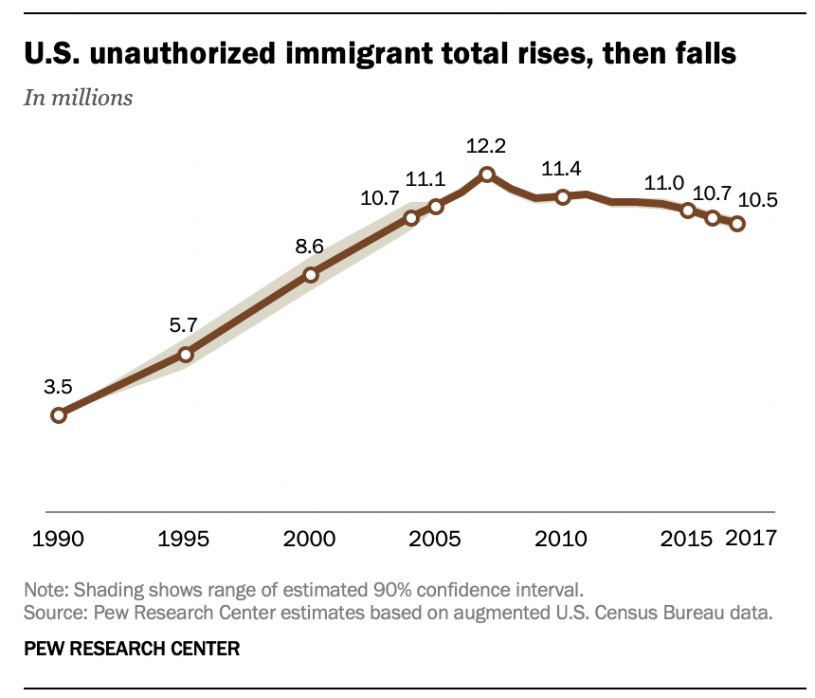
Illegal Immigration in U.S.: Boom & Decline

Slide 74
III) C) 3. Immigration
1 in 8 U.S. residents is an immigrant, highest since border closed in 1924
1 in 4 is illegal, flow of illegal exceeded legal in early 2000s
U.S. immigration law is biased toward high-skilled workers
Economic impacts:
Theory: similar to population
Less capital/worker (more competition) in short run
No effect (capital accumulation or positive effect (productivity) in long run
Depends on type (low- or high-skilled)
Empirically (highly debated):
Seems to have promoted growth, but hurt low skill workers in short run (Borjas & Doran)

Slide 75
III) C) 3. Immigration
1 in 8 U.S. residents is an immigrant, highest since border closed in 1924
1 in 4 is illegal, flow of illegal exceeded legal in early 2000s
U.S. immigration law is biased toward high-skilled workers
Economic impacts:
Theory: similar to population
Less capital/worker (more competition) in short run
No effect (capital accumulation or positive effect (productivity) in long run
Depends on type (low- or high-skilled)
Empirically (highly debated):
Seems to have promoted growth, but hurt low skill workers in short run (Borjas & Doran)

Slide 76
Two Countries with Closed Borders One country has higher labor demand, wages
MPL1
MPL2
wage2
wage1
rich
country
wage
Poor
country
wage
w2
w1
01
L1
L2
02

Slide 77
After opening borders People emigrate to high wage country
MPL1
MPL2
wage2
wage1
wage2
rich
country
wage
Poor
country
wage
w2
w1
01
L1
L2
02

Slide 78
Effect on Poor Country
Owners income falls
MPL1
Increase wage
in poor country
MPL2
wage1
wage2
rich
country
wage
Poor
country
wage
w2
w1
01
L1
L2
02

Slide 79
Effect on Rich Country Wages converge
Owners income rises
MPL1
Decrease wage
in rich country
MPL2
wage1
wage2
rich
country
wage
Poor
country
wage
w2
w1
01
L1
L2
02

Slide 80
Increase in Efficiency
MPL1
Global output gain
MPL2
wage1
wage2
rich
country
wage
Poor
country
wage
w2
w1
01
L1
L2
02

Slide 81
Summary of Impacts
Just like trade and FDI, immigration creates winners and losers
Winners: poor country workers (both movers and stayers), rich country owners (higher rents)
Losers: poor country owners (lower rents), rich country workers
How else could we get this?
Trade – export labor-intensive goods
Not for services/nontradables
Capital flows and FDI
These alternatives prevent breaking up families (in poor country) but potentially disruptive to communities (in rich country)

Slide 82
Right to Migrate
Catholic social thought has always supported right to migrate
Universal destination of earth’s resources
Right to work
Solidarity, subsidiarity
Much like property, the right to migrate is not absolute
Government can make decisions restricting right, especially for common good (easy example: suspected terrorists)

Slide 83
Proper Response Toward Immigrants
Response to migrants should reflect justice and Christian charity
“I was a stranger and you welcomed me…” Matthew 25
“We cannot insist too much on the duty of giving foreigners a hospitable reception. It is a duty imposed by human solidarity and by Christian charity, and it is incumbent upon families and educational institutions in the host nations. “ PP 67
“Emigrant workers should also be given a warm welcome. Their living conditions are often inhuman, and they must scrimp on their earnings in order to send help to their families who have remained behind in their native land in poverty. “ PP 69
“Do unto others, as you would have them do unto you.”
– Pope Francis to U.S. Congress in 2015

Slide 84
Other political issues with immigration
Culture:
Cultural preservation
Cultural hegemony, racism, etc.
Crime
National security
Government budget (debated)
Immigrants pay taxes but also use services
Immigrants from Asia and Europe are net gain to government budget, from Latin America are net loss
Closely tied to education level

Slide 85
End of Lecture 26

